Slide 1
Potential Impacts of Autonomous Vehicles in Calgary, Alberta
Kristina Hill, P.Eng

Slide 2
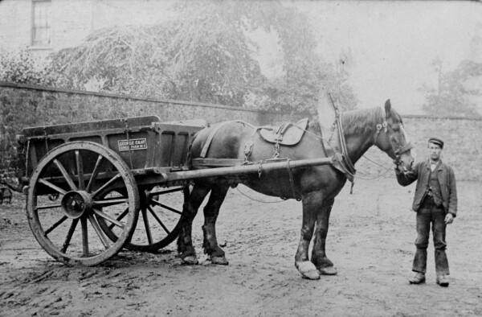
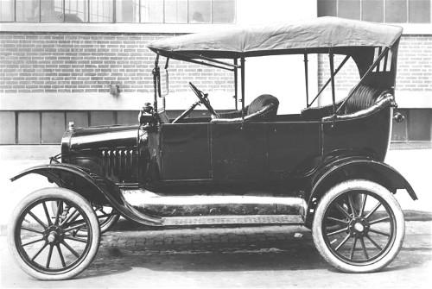
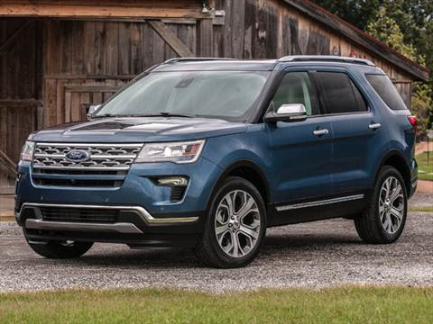
Autonomous Transformation
Fully autonomous vehicles stand to transform travel behaviour in ways that haven’t been seen in over 100 years.
First combustion engines became popular in early 1900s
Over 100 years later, technology has improved safety and efficiency, but vehicle operation is largely the same.

Slide 3
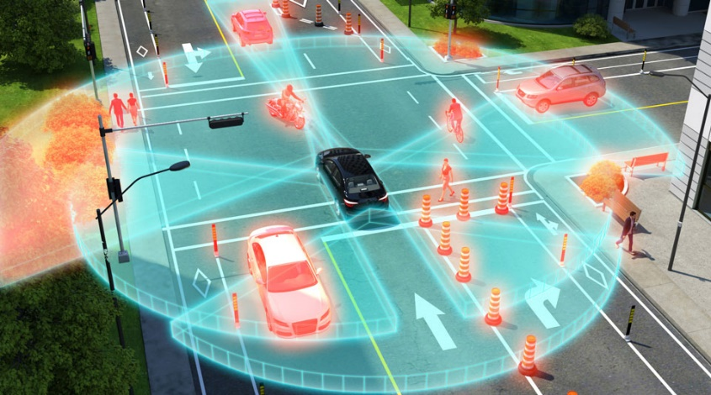
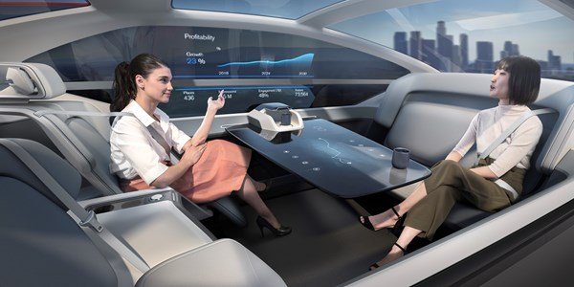
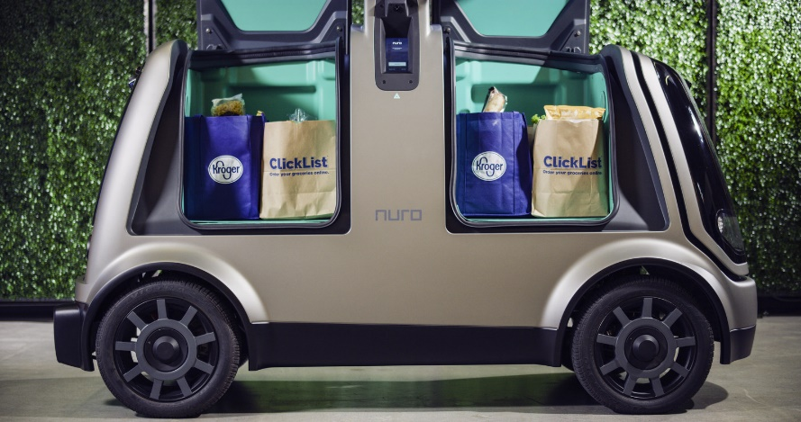
Potential of Autonomous Vehicles
Autonomous Vehicles (AV) have the potential to re-shape transportation and economic systems.
  How vehicles interact with the environment
  How the vehicles are being used
  Who is able to access vehicles
A lot of uncertainty about how and when this transformation will take place

Slide 4
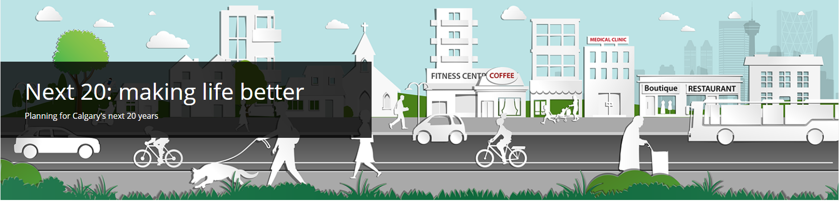
Calgary – Next 20 Years
City of Calgary is reviewing long range city transportation plans
AVs present a challenge
  Have a significant impact on travel behaviour
  Have significant economic impacts
  A lot of uncertainty around the adoption of this technology
Using existing tools to simulate the behaviour of autonomous vehicles may help provide some information about possible impacts.

Slide 5




Welcome to 2039… Calgary in about 20 Years
Calgary’s population is expected to grow by 40% over the next 20 years
In baseline 2039 forecasts, Calgarians make about 7.8 million trips in a day
2018
1.3 Million
2039
1.8 Million
80% of trips are made by autos
8% of trips are made by transit
12% of trips are made by walking or cycling

Slide 6
How would AVs change behaviour in Calgary?
First scenario simulated a scenario where all vehicles were fully autonomous
  25% Road capacity increase
  Improved perception of auto travel time
  Travellers are dropped off at destination
  Empty cars return home if parking costs are high
  Anyone over 12 years can have a driver’s license
Travel Impacts – Calgarian make more trips… 8.1 Million trips per day
Auto trips
+12%
Transit trips
-32%
Active trips
-36%

Slide 7
AV Impact to SOV Mode Share
Travellers shifted from using transit and walk modes to use SOV mode
Empty vehicles were only about 2% of trips – likely because very few places in Calgary have parking costs.
Person Category | SOV Mode Share |  | Increase in SOV Auto Travel
 | Base | AV
Children (Under 18 years of age) | 3% | 9% | 190%
Adults (18 – 65 years of age) | 52% | 56% | 15%
Seniors (65 years and older) | 43% | 57% | 35%
Persons w/ Disabilities | 40% | 45% | 20%

Slide 8




Impacts of Increased Auto Travel on Congestion
Vehicle km travelled increased by 55%
Vehicle hours travelled increased by 60%
Average speed decreased from 53 kph to 51 kph
CO2 Emissions increased by 35% with ICE vehicles
The increase in SOV travel leads to an increase in congestion on city streets
Congestion continues to be an issue that needs to be effectively managed

Slide 9


How to mitigate congestion?
One method: investing in other transportation modes – such as Transit
Calgary Transit spends almost half of their budget on drivers.
  A fully autonomous transit system would not have to pay drivers
  Funds could be use for other purposes
Reduce Headways
Reduce Transit Fares
On Demand
Reduce transit headways by 65%
Reduced fares by 85%
Reduced walk / wait times to 0
Reduced fares by 85%

Slide 10
Impact of Improving Transit Service / Costs
Investment in On Demand transit with a fare reduction had the largest impact
Even with significant investment in transit, the auto mode share is higher than in the baseline scenario

Slide 11

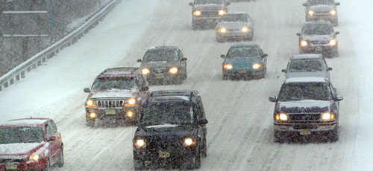
AV Technology in Calgary
Most AVs now use cameras to detect lane markings
  Testing is done in Arizona / California
Lane markings are not clear for almost 6 months of the year
Calgary will likely need to invest in some kind of infrastructure so AVs know where to go

Slide 12
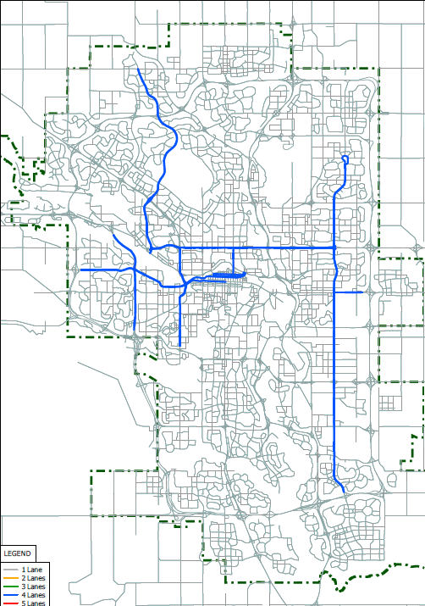
AV Connected Corridors
It was assumed that in Calgary, some level of infrastructure investment needs to be made so the cars can “talk” to the road as well as each other.
  50% of households were assigned an “AV” vehicle
  AV capacity benefits were applied to specified corridors only
  Removed adjustments to empty vehicle, driver’s licence, time perception etc.

Slide 13
AV Corridor Impact to Travel Behaviour
Few impacts to city-wide travel behaviour
  Total daily trips is similar to the base scenario
  No significant change to mode split

Slide 14
Comparing AV and Non-AV Households
AV households are more likely to use auto mode than non-AV households.
Effects were limited to adults and seniors.
  Children and persons with disabilities were only able to use AVs if they had a driver’s licence.

Slide 15
Next Steps / Other Improvements
Investigate network effects of AVs
Develop a taxi mode for the model to improve ride-sharing scenarios
Run a scenario with cheaper parking zones outside the downtown core
  Simulate people driving home or driving to cheap parking
Consider how to code a scenario where empty vehicles roam rather than go home.

Slide 16
Observations and Conclusions
Implementation of AV technology is uncertain
  Difficult to include specifics in city plans
Transportation system congestion is likely to get worse as AVs are implemented
  Invest in alternate modes such as public transit
  Road pricing
Existing tools can provide some insight into effects that AVs may have in a city
  Shift away from efficient, sustainable modes like transit and walking to SOV.
  Regional models can start to quantify relative changes in volumes, transit ridership, VKT, VHT, and other congestion measures

Slide 17
Questions? Comments?

